Slide 1
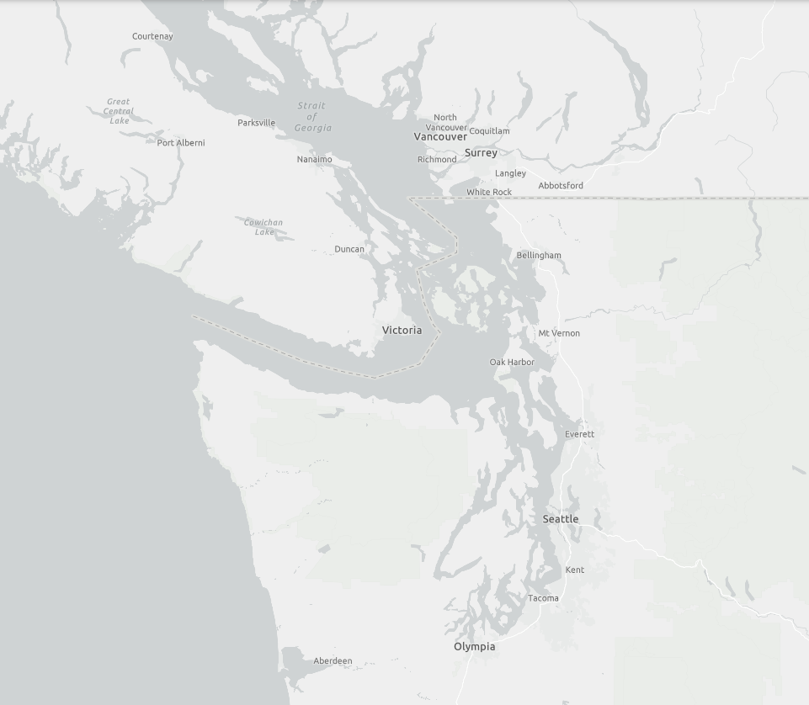
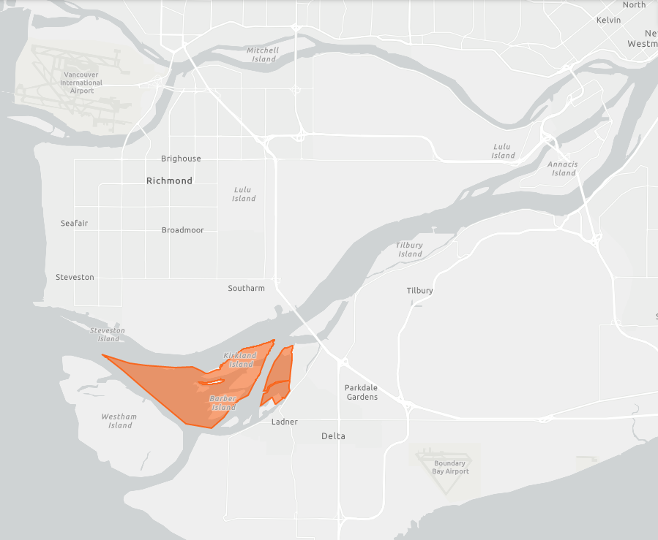
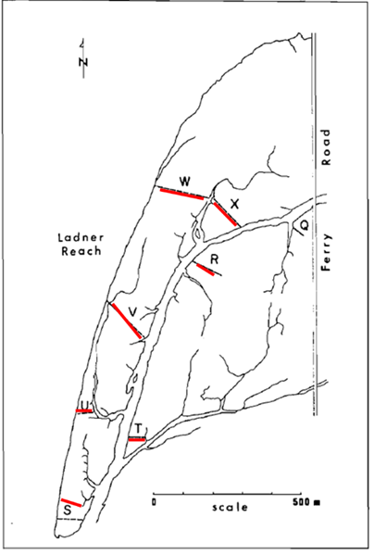

A
BRITISH COLUMBIA
B
C
Vancouver International Airport
Vancouver
Road
Richmond
Victoria
Ladner
Reach
Ferry
Fraser River
Seattle
Ladner
Ladner
WASHINGTON
0
scale
500 m
Notes:
https://www.arcgis.com/apps/webappviewer/index.html?id=40ad09a245034674b59dd4d6c081782c&marker=-119.22943921356098,52.79175096140276,,,,&markertemplate=%7B%22title%22:%22Cranberry%20Marsh/Starratt%20WMA%22,%22longitude%22:-119.22943921356098,%22latitude%22:52.79175096140276,%22isIncludeShareUrl%22:true%7D&level=7

Slide 2

A
BRITISH COLUMBIA
B
C
Vancouver International Airport
Vancouver
Richmond
Victoria
Fraser River
Ladner
Seattle
Ladner
WASHINGTON
Notes:
https://www.arcgis.com/apps/webappviewer/index.html?id=40ad09a245034674b59dd4d6c081782c&marker=-119.22943921356098,52.79175096140276,,,,&markertemplate=%7B%22title%22:%22Cranberry%20Marsh/Starratt%20WMA%22,%22longitude%22:-119.22943921356098,%22latitude%22:52.79175096140276,%22isIncludeShareUrl%22:true%7D&level=7

Slide 3
BRITISH COLUMBIA
C
Vancouver International Airport
Vancouver
Richmond
Victoria
Fraser River
Ladner
Seattle
Ladner
WASHINGTON
Notes:
https://www.arcgis.com/apps/webappviewer/index.html?id=40ad09a245034674b59dd4d6c081782c&marker=-119.22943921356098,52.79175096140276,,,,&markertemplate=%7B%22title%22:%22Cranberry%20Marsh/Starratt%20WMA%22,%22longitude%22:-119.22943921356098,%22latitude%22:52.79175096140276,%22isIncludeShareUrl%22:true%7D&level=7

Slide 4
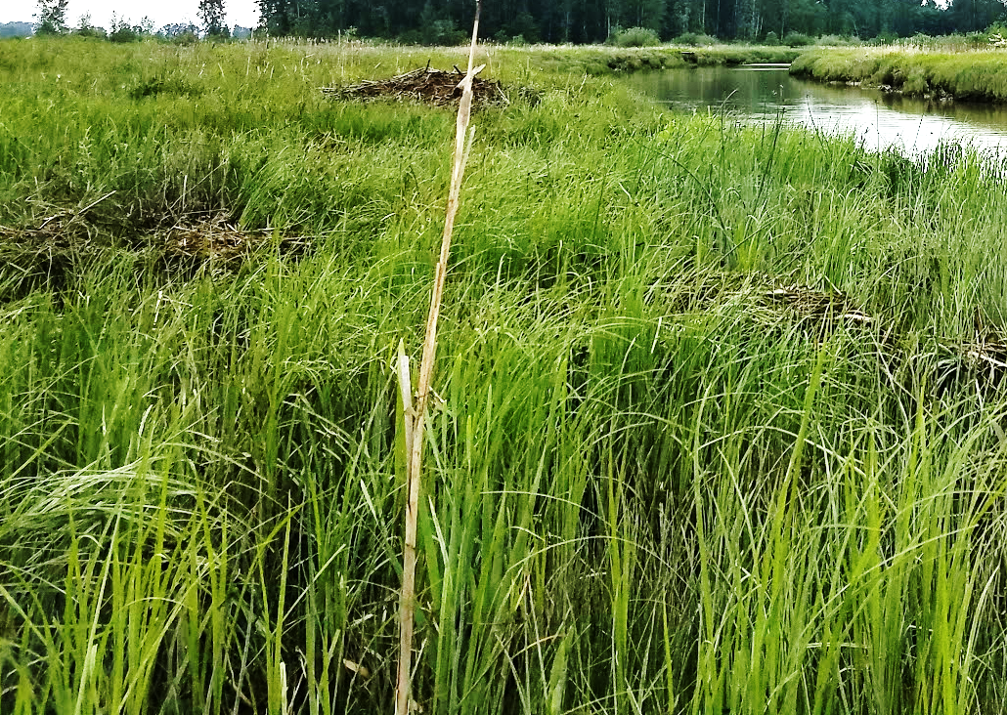
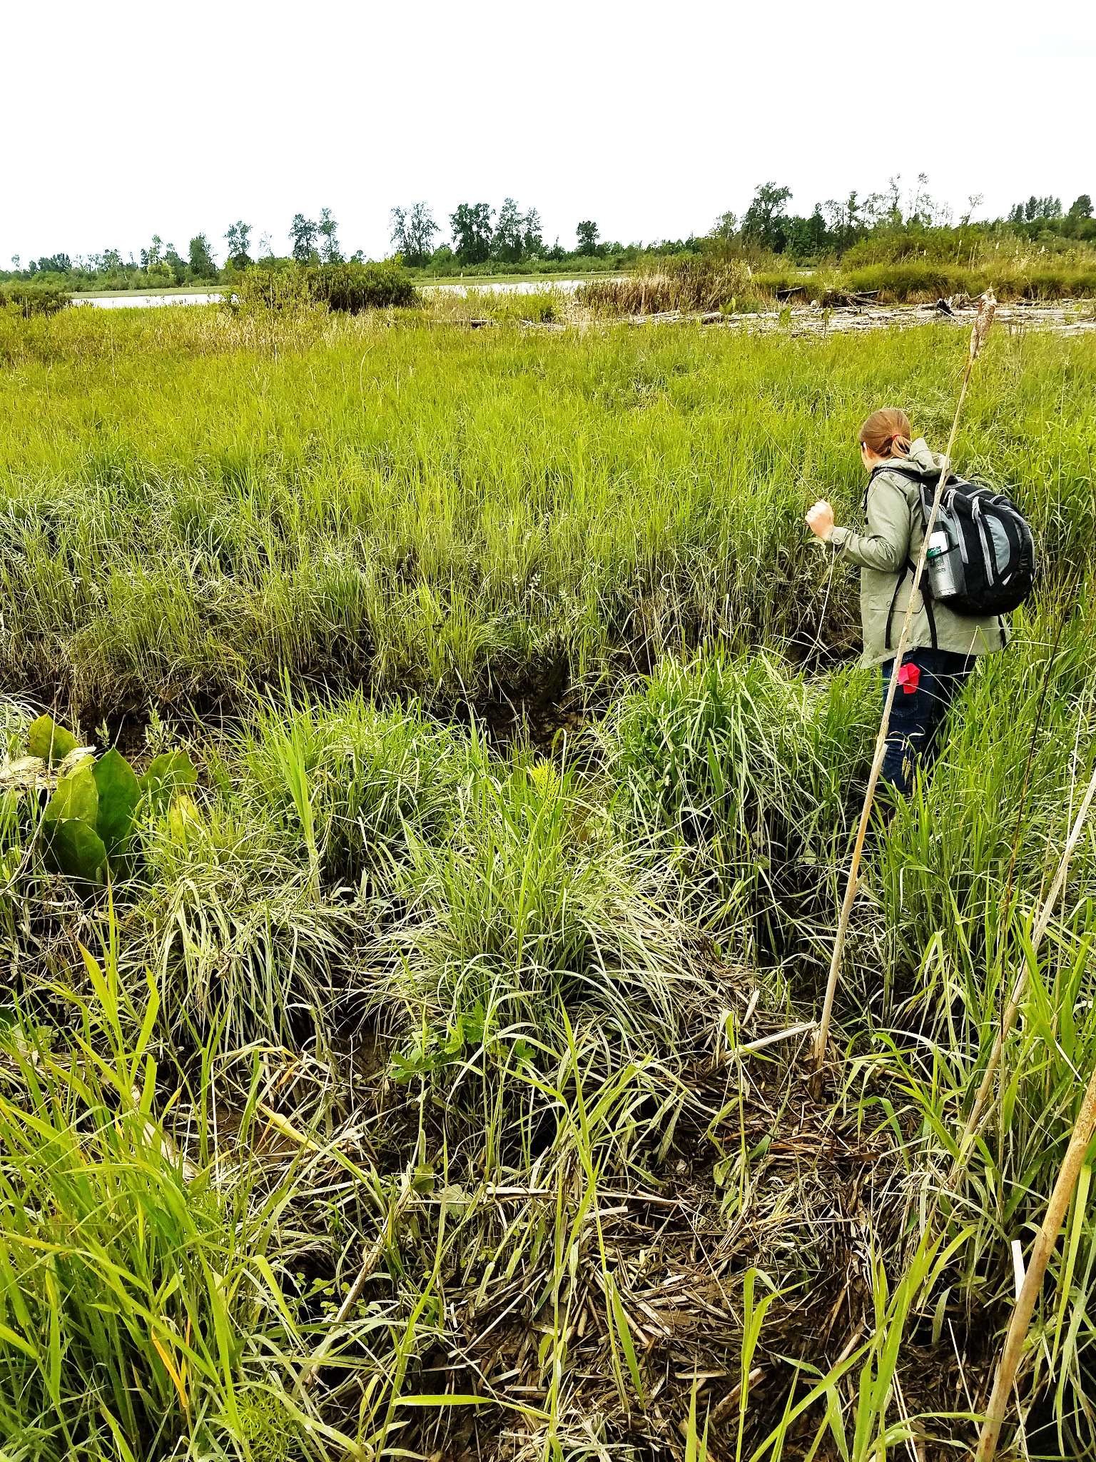
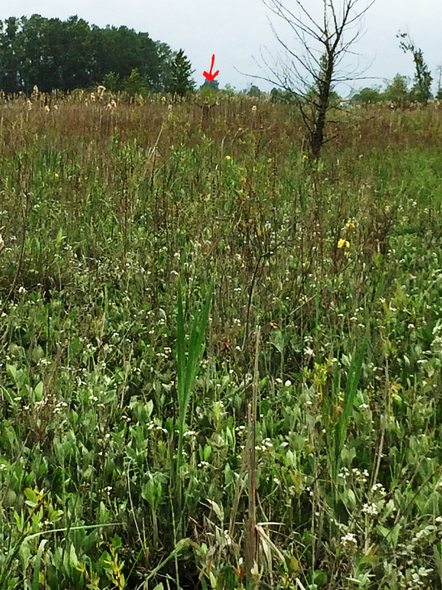
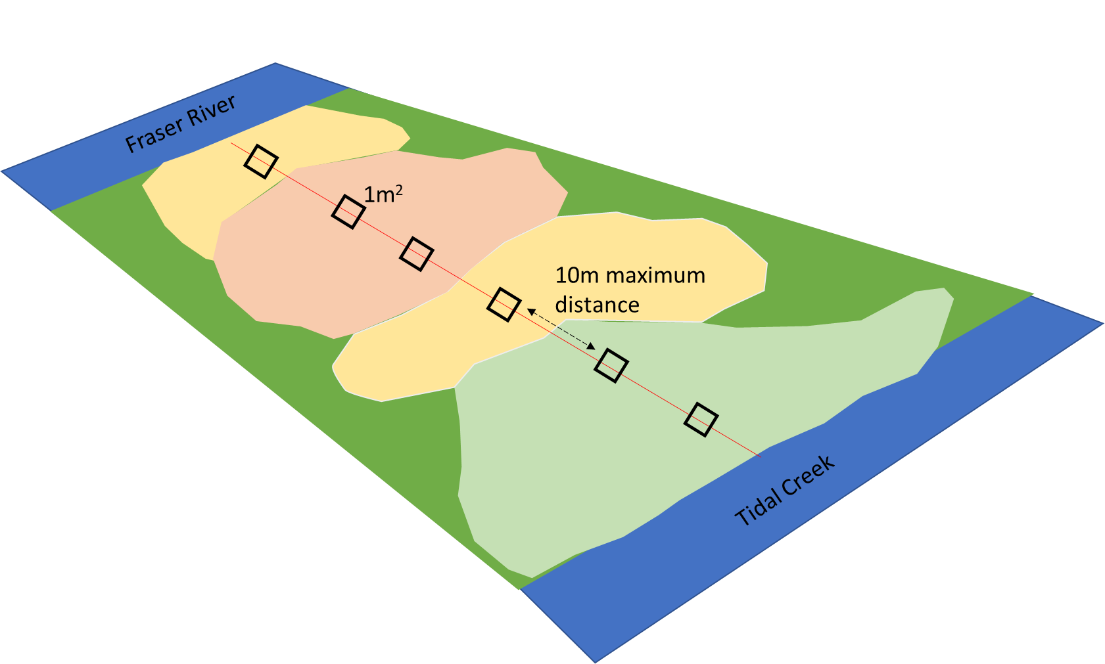
A
B
C
D

Slide 5
Fraser River
1m²
10m maximum distance
Tidal Creek
Notes:
Sampling schematic along sample transect of unique community types, represented by irregular polygons. 1m2 sampling plots were placed at the center of the unique community polygon, or every 10m of transect length, whichever was less. Illustration not to scale.

Slide 6
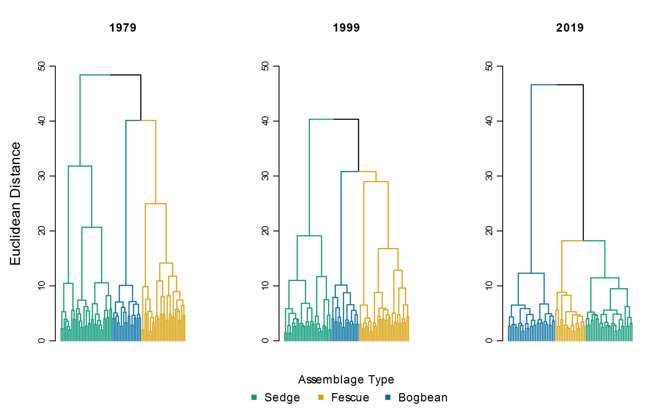

Slide 7
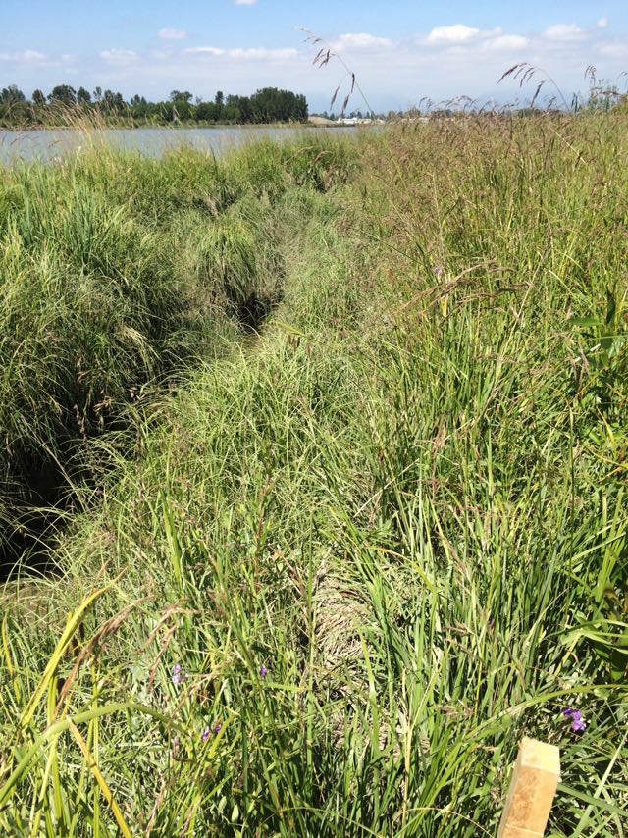
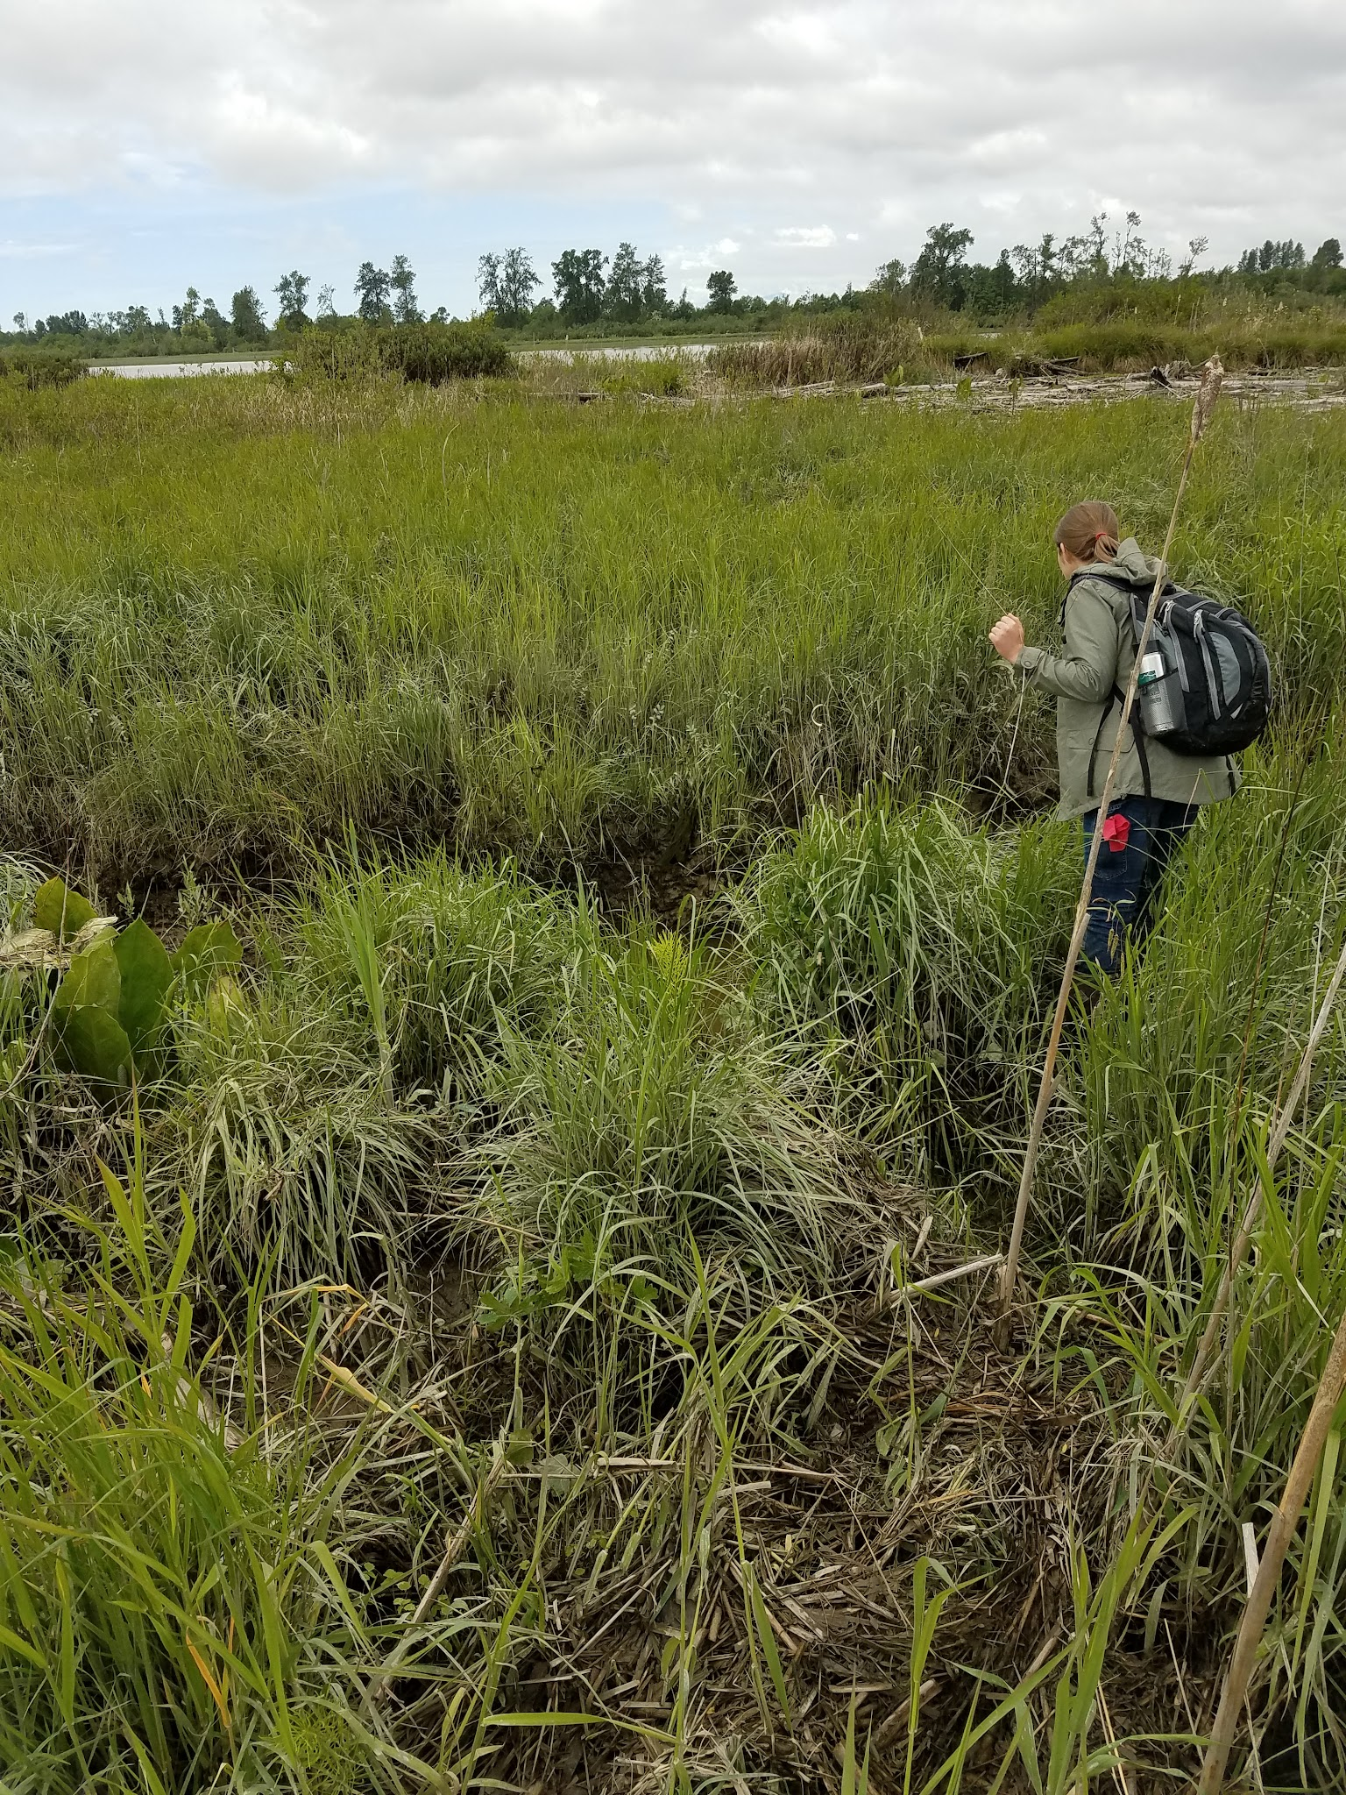
Fescue (foreground)

Slide 8
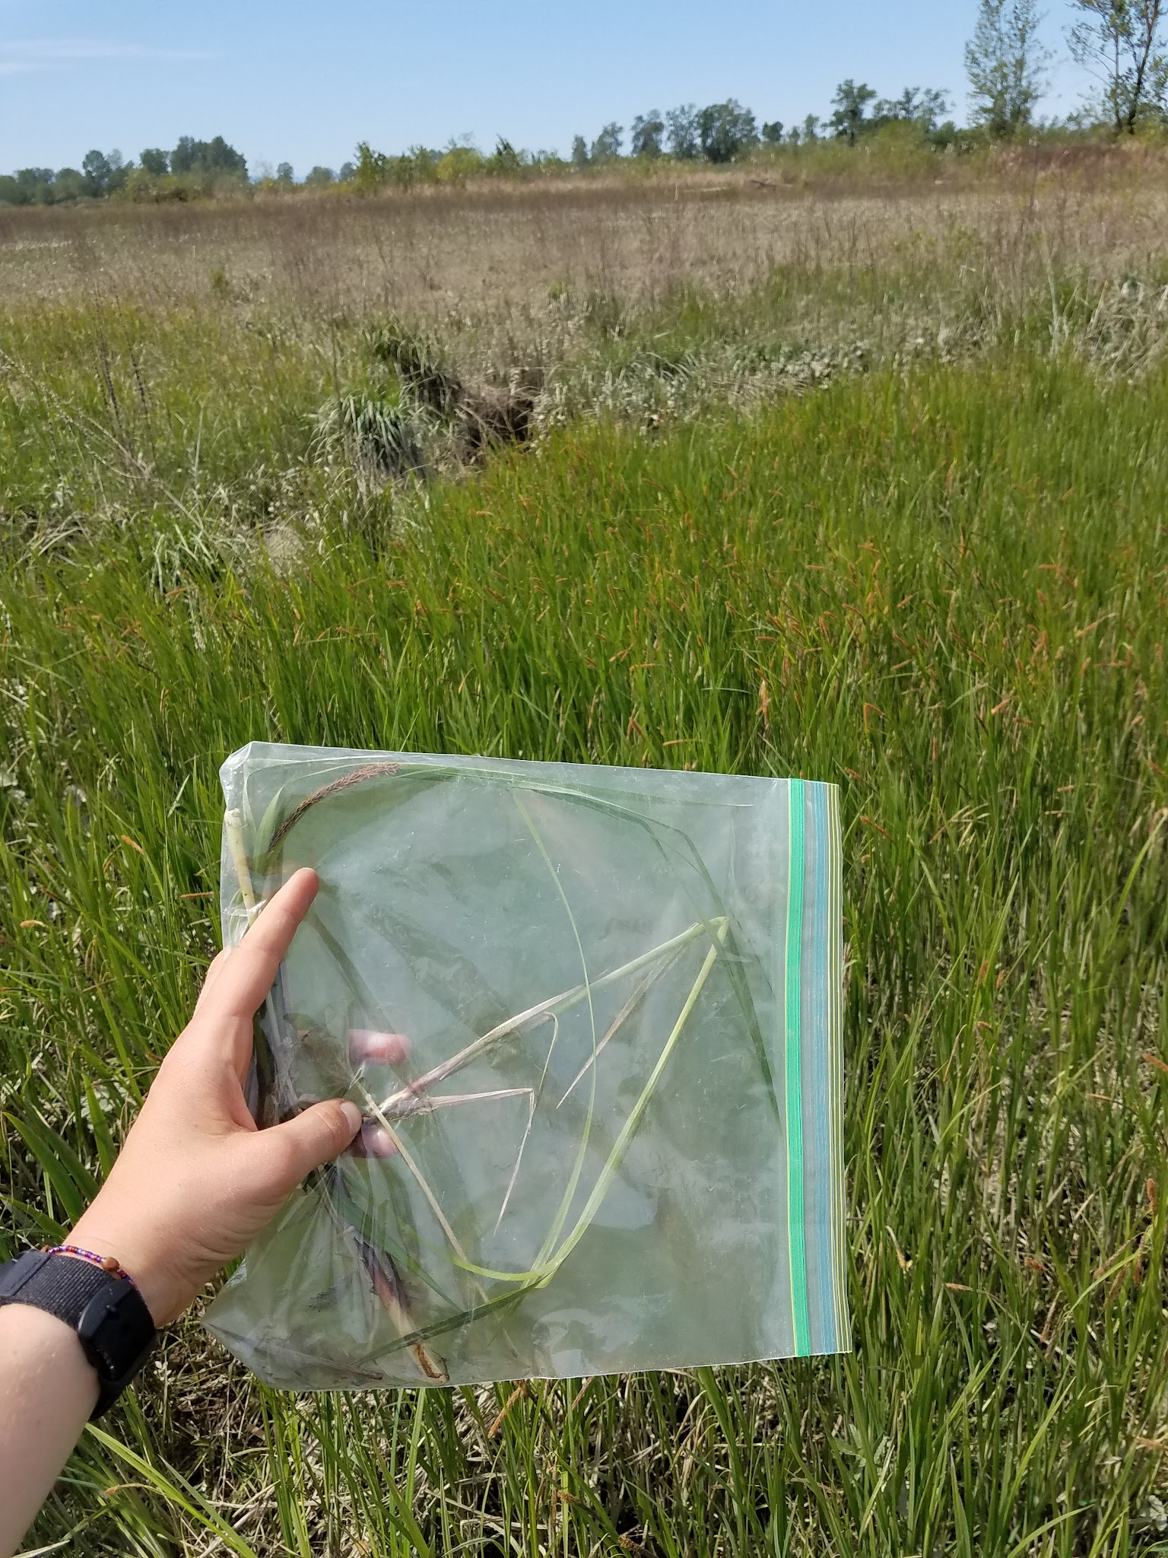
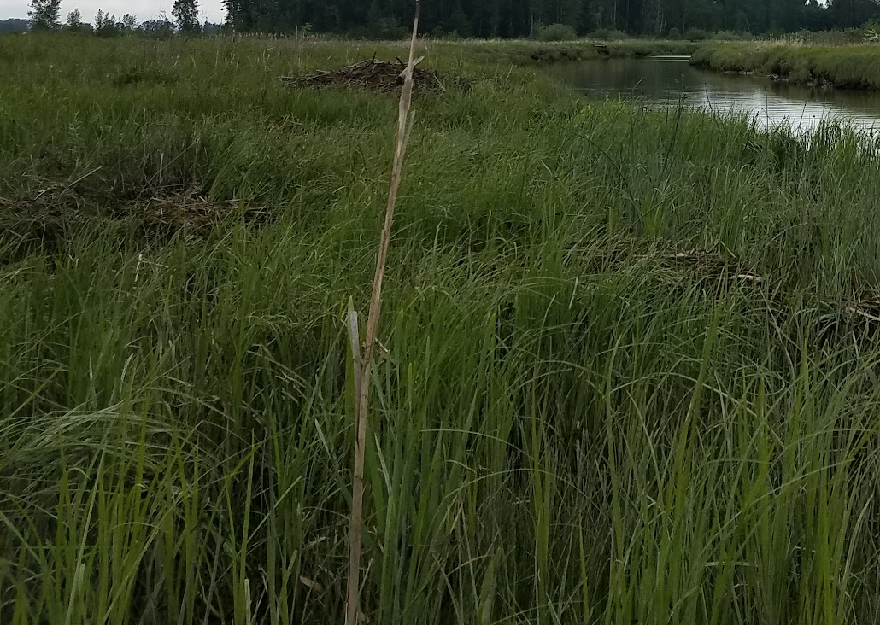
sedge

Slide 9
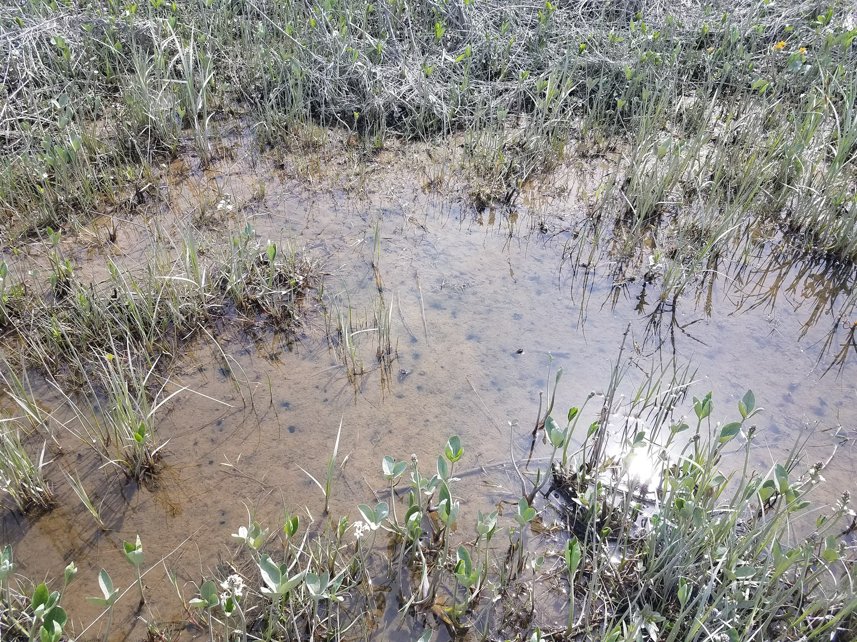
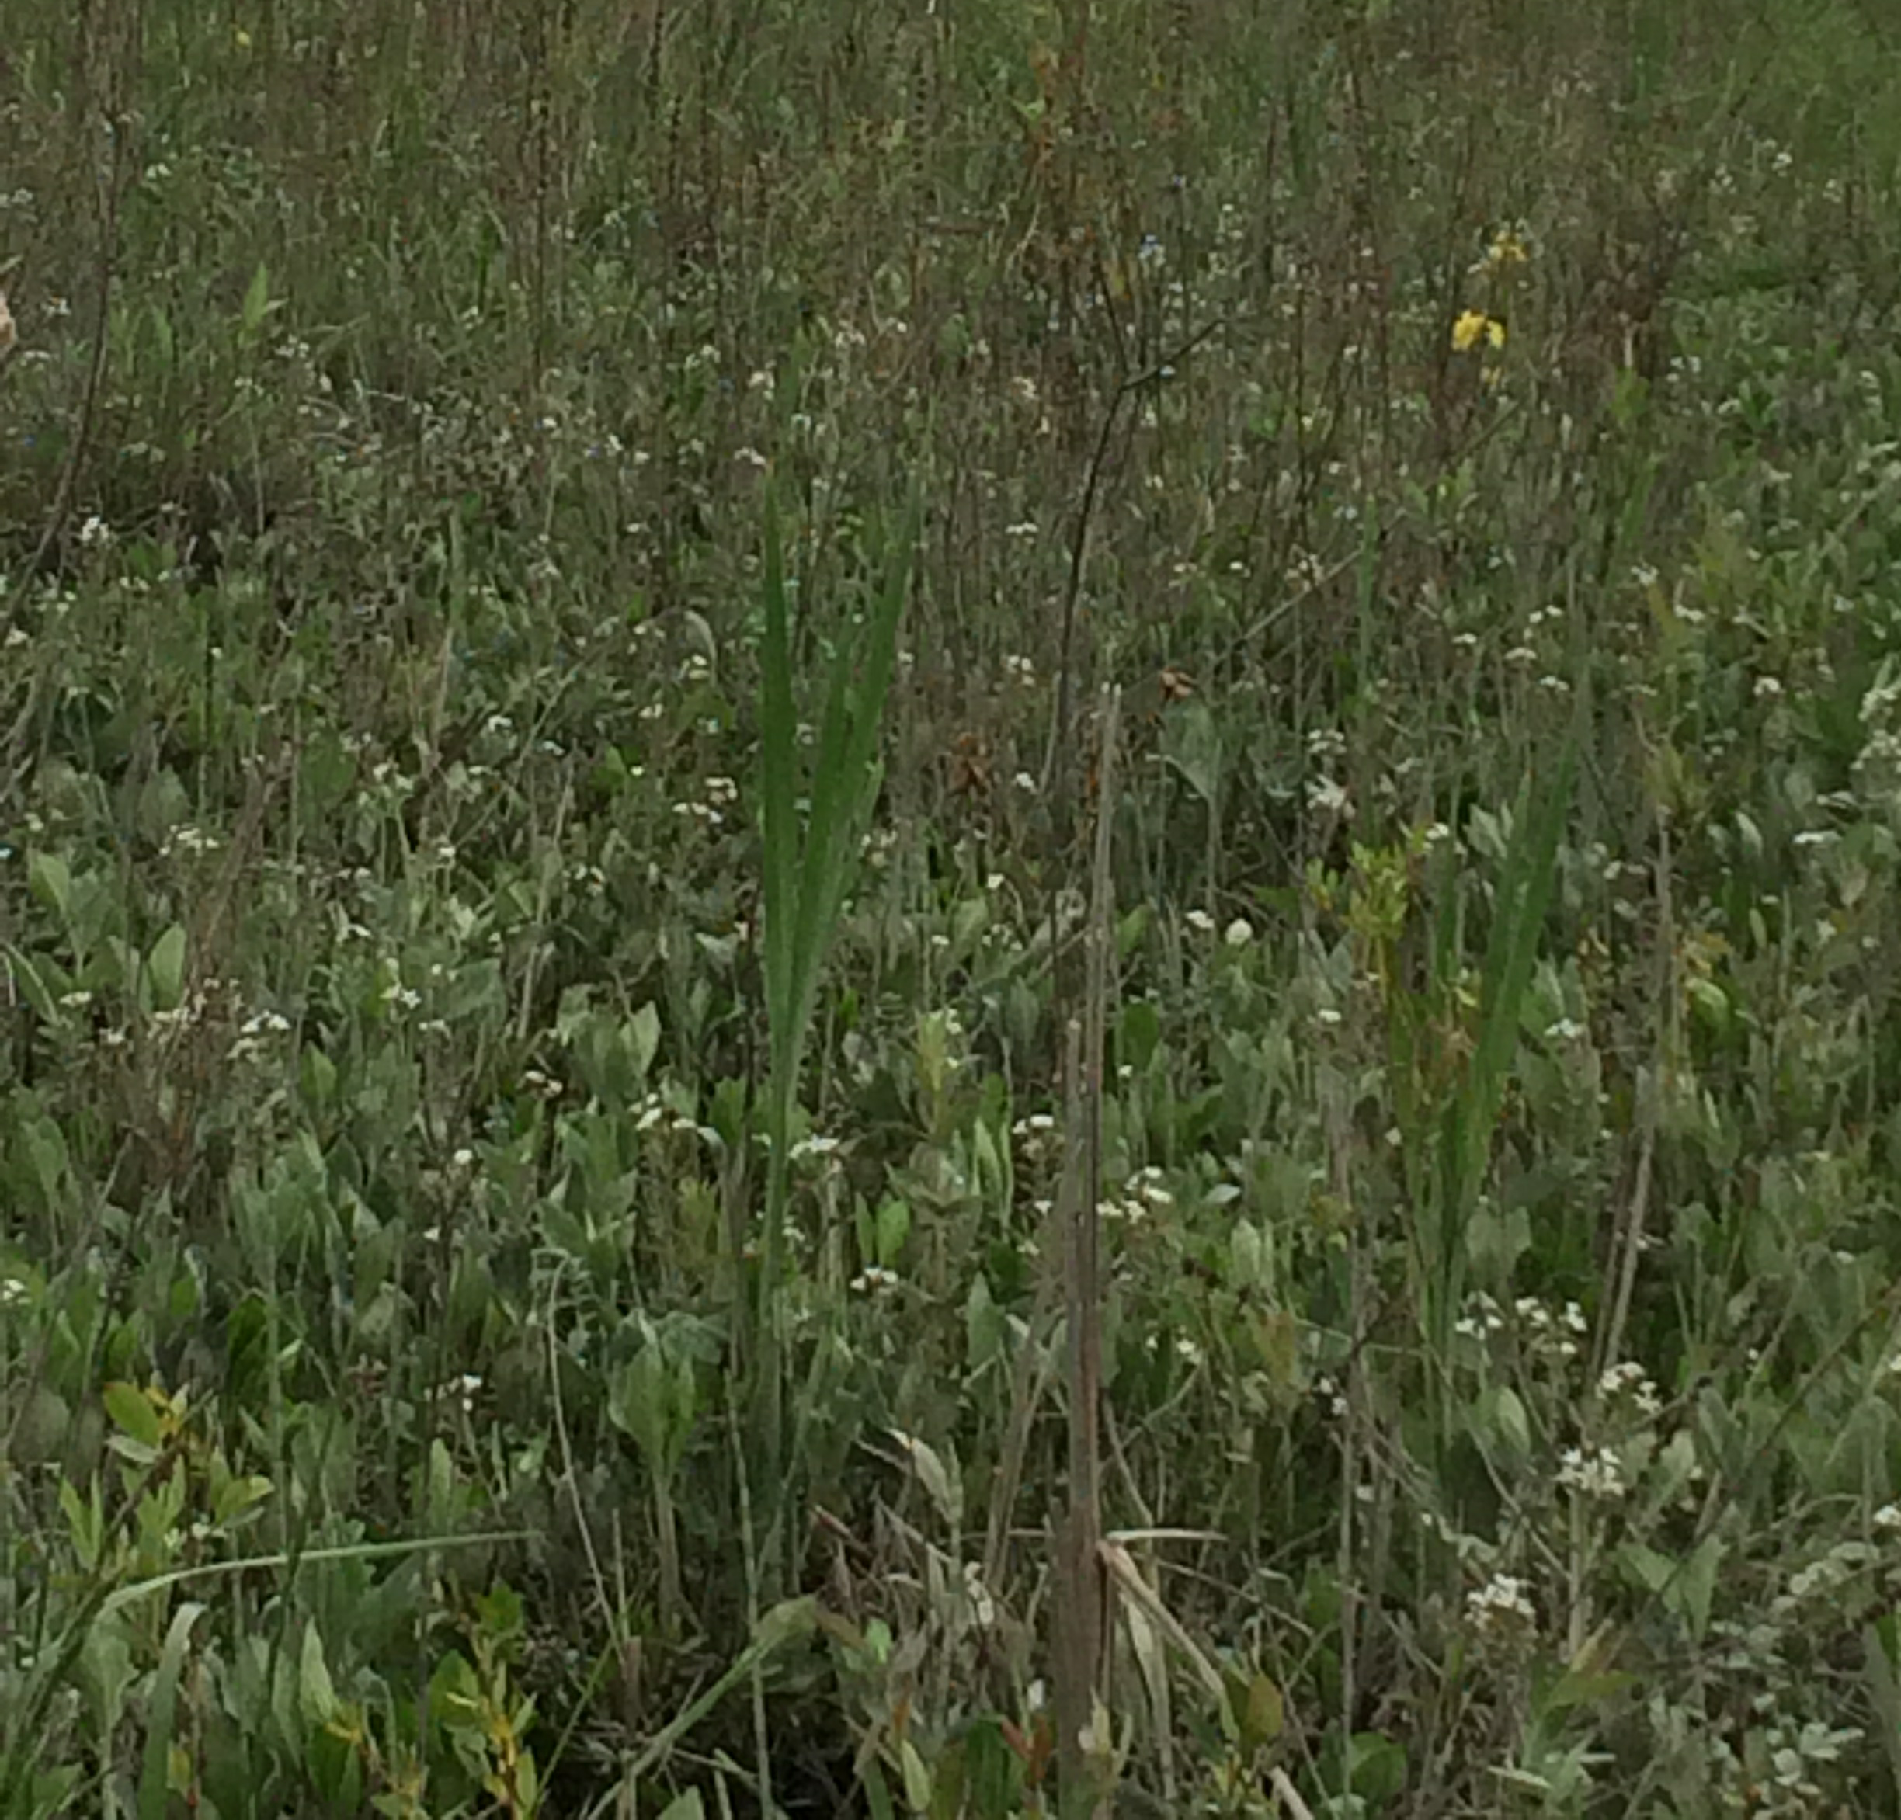

Slide 10
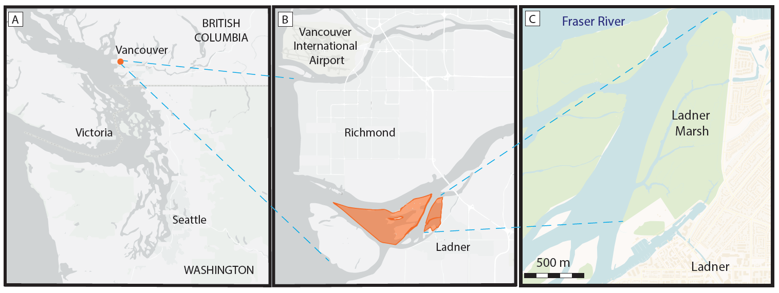
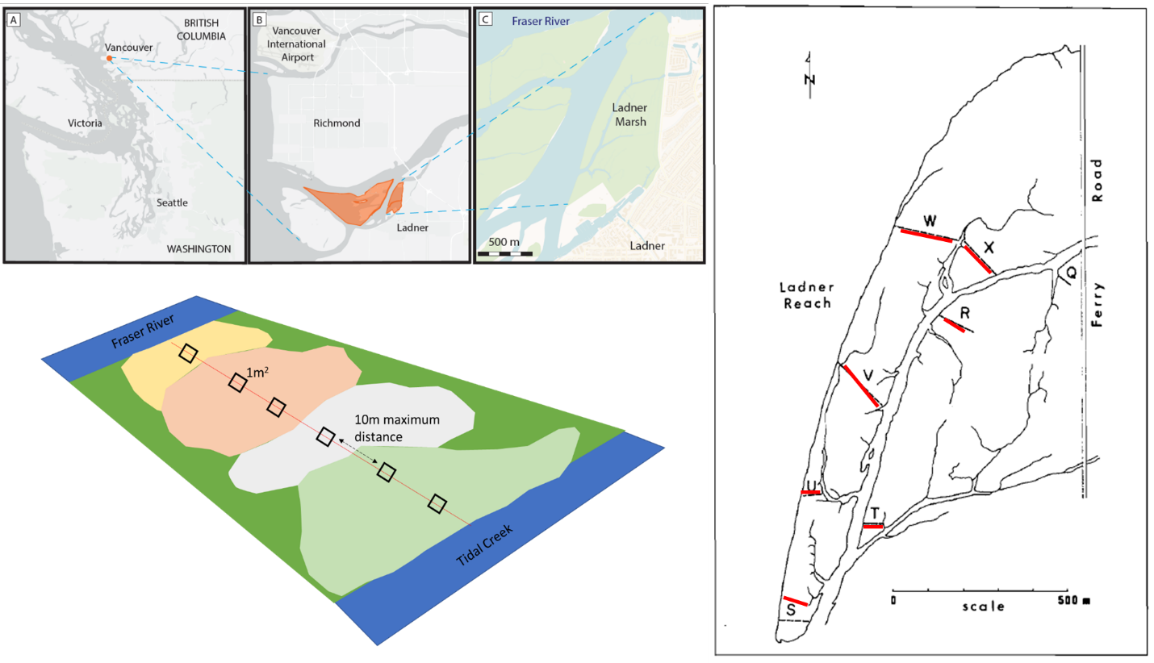

F
A
B
C
Sedge
D
E
Fescue
Bogbean

Slide 11
Mean Highest High Water (MHHW)
Mean High Water (MHW)

